Slide 1
Global quantification of mammalian gene expression control
Schwanhäusser, B., Busse, D., Li, N., Dittmar, G., Schuchhardt, J., Wolf, J., Selbach, M. (2011).
Nature, 473(7347), 337–42. doi:10.1038/nature1009
Kobi Perl
Notes:
מסר – Respect the data

Slide 2
The Plan
Motivation
Measuring Turnover
Quantitative Model of Gene Expression
Control of Gene Expression
Half-lives and Gene Function
Summary
Ideas for using the results
Notes:
מסר – שזה data חדש ושימושי.

Slide 3
Motivation
Correlation between mRNA and protein expression levels in mammals are low
Possible causes:
Many proteomic studies are limited to a few hundred genes
Protein and mRNA levels are measured in different experiments
Protein and mRNA levels result from coupled processes – synthesis and degradation
The study tries to overcome those limitations by:
Studying processes rates
For thousands of genes
For both protein and mRNA at once
Notes:
Low – 0.3 to 0.6 when comparing RNA-seq to modern day proteomics
Many proteomic studies are limited to a few hundred genes – becoming less relevant in 2013.
Protein and mRNA levels are measured in different experiments – very relevant even today

Slide 4
Measuring turnover - Pulse Labeling
Stable isotope labelling by amino acids in cell culture (SILAC)
Non-labelled cells → heavy SILAC growth medium
Newly synthesized proteins incorporate the heavy label while pre-existing proteins remain in the light form
This strategy can be used to measure protein turnover or relative changes in protein translation
For mRNAs
Essentially the same with a nucleoside analogue (4sU)
Notes:
Relative changes in protein translation – כמו אחרי החדרת miRNA-ים לתאים

Slide 5
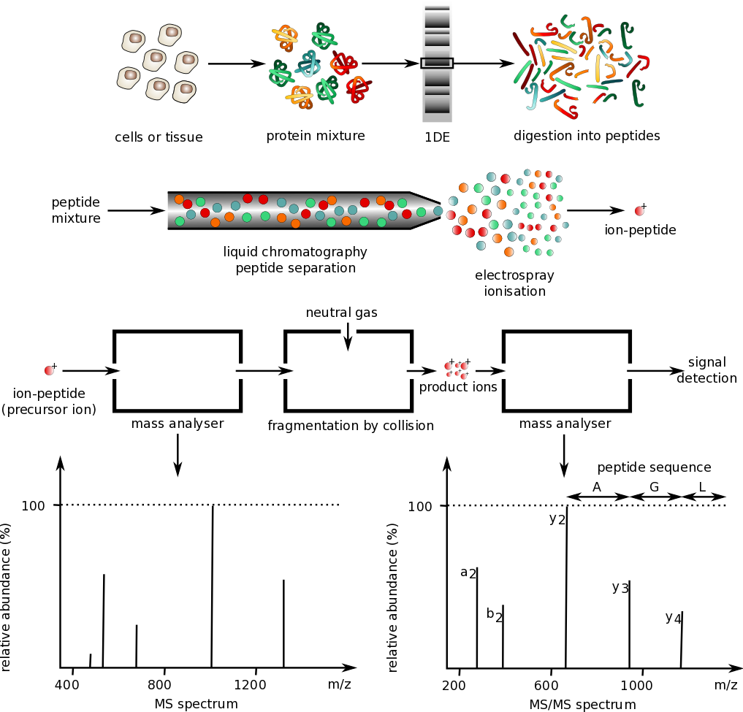
Measuring turnover – Mass Spec
Typical SILAC labeling uses lysine and arginine, which in combination with trypsin digestion results in labeling of every peptide in the mixture
SILAC experiments involve differential labeling of two to three cell types
The heavy amino acids create a distinct and known mass difference between the samples
Notes:
More data in: https://www.biochem.mpg.de/221777/SILAC
(It’s easier to analyze if you know that each peptide contains exactly one heavier amino acid)

Slide 6
Measuring turnover - Experiment
Cell Population: NIH3T3 mouse fibroblasts
Growth Phase: Exponential growth
Method: Parallel metabolic pulse labelling with amino acids and 4sU to measure simultaneously protein and mRNA turnover
Protein samples were collected at three time points (1.5h, 4.5h, 13.5h)
mRNA was separated after 2h of pulse labeling, fractionated into newly synthesized and pre-existing, sequenced and quantified
Notes:
mRNA – 3sU is biotinylated to allow separation

Slide 7
Measuring turnover - Proteins
84,676 peptides → 6,445 proteins → 5,279 quantified by at least three H/L peptide ratios
For constant incorporation rates the logarithm of H/L ratios should increase linearly with time (next slide)
93% of proteins showed excellent linear correlation indicated by a variability of the linear regression slope smaller than 1% (assessed by LOOCV)
In total, confident set of 5,028 protein half-lives calculated from the slope of the regression line
Notes:
Why 5,028? Because the half-lives are only calculated for fits that satisfy R2 ≥ 0.9 (n = 4,906) or measurements of one time point with minimum three counts (n = 95) + for proteins that failed the quality check (R2 < 0.9) but had a ratio r ≥ 0.5 at the first time point (1.5 h), that point was used (n=27) (From the set of 5,279)
LOOCV = Leave one out cross validation

Slide 8
Measuring turnover - Proteins
Protein is decaying in a first order reaction:
$$\begin{matrix}\frac{dP_{L}}{dt}=k_{dp}P_{L} \\ \frac{dP_{L}}{P_{L}}=k_{dp}dt \\ \int_{P_{0}}^{P_{L}}{\frac{dP_{L}}{P_{L}}}=\int_{0}^{t}{k_{dp}dt} \\ ln\left(P_{L}\right)−ln\left(P_{0}\right)=k_{dp}t \\ P_{L}=P_{0}e^{−k_{dp}t}\end{matrix}$$
Mark the ratio r:
$$r=\frac{P_{H}}{P_{L}}$$
Total concentration is assumed to double during the duration of one cell-cycle:
$P_{H}\left(t\right)=P_{total}\left(t\right)−P_{L}\left(t\right)=P_{0}2^{t/{t_{cc}}}−P_{L}\left(t\right)$
Substituting into the ratio:
$$\begin{matrix}r\left(t\right)=\frac{P_{0}2^{t/{t_{cc}}}−P_{L}\left(t\right)}{P_{L}\left(t\right)}=\frac{2^{t/{t_{cc}}}}{e^{−k_{dp}t}}−1 \\ e^{−k_{dp}t}=\frac{2^{t/{t_{cc}}}}{r\left(t\right)+1} \\ −k_{dp}t=\frac{t}{t_{cc}}\log_{e}2−\log_{e}\left(r\left(t\right)+1\right) \\ k_{dp}=−\frac{\log_{e}2}{t_{cc}}+\frac{\log_{e}\left(r\left(t\right)+1\right)}{t}\end{matrix}$$
Writing it as a linear model with zero intercept:
$$f\left(t\right)=βt, f\left(t\right)=log\left(r\left(t\right)+1\right), β=k_{dp}+\frac{\log_{e}2}{t_{cc}}$$
The maximum likelihood estimator is:
$$β=\frac{\sum_{i=1}^{m}{t_{i}f\left(t_{i}\right)}}{\sum_{i=1}^{m}{{t_{i}}^{2}}}$$
Ergo,
$$k_{dp}=\frac{\sum_{i=1}^{m}{\log_{e}\left(r_{t_{i}}+1\right)t_{i}}}{\sum_{i=1}^{m}{{t_{i}}^{2}}}−\frac{\log_{e}2}{t_{cc}}$$

Slide 9
Measuring turnover - Proteins
Protein half-life is equal to: $T_{1/2}=\frac{\log_{e}{2}}{k_{dp}}$
When $T_{1/2}$ approach infinity ($k_{dp}$→ 0) then the ratio is close to the minimal value expected due to cell division $\frac{\log_{e}{2}}{t_{cc}}$
Long half-lives (>200 h) are sensitive to variations in cell cycle times!
For very unstable proteins the ratio measurements saturate at the late time point. Therefore, only the first time point was used to calculate the half-life
Short half-lives (<30 min) cannot be accurately quantified
Notes:
Criterion for very unstable proteins: , for proteins that failed the quality check (R2 < 0.9) but had a ratio r ≥ 0.5 at the first time point (1.5 h), (there where 27)

Slide 10
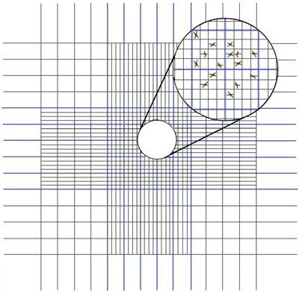
Measuring turnover - Proteins
Determine $t_{cc}$
Cells of two culture dishes were pooled and counted six times with haemocytometers at 0.75 h, 5 h, 9 h, 13.25 h
$t_{cc}$ is estimated assuming exponential growth and neglecting cell death, using linear regression
The uncertainty of the parameters was determined by bootstrapping
$t_{cc}$ was determined as 19.9h < 27.5h < 33.6h.

Slide 11
Measuring turnover – Proteins
Protein turnover can be under-estimated due to the presence of light (L) amino acids that remain in the precursor pool after transferring cells to heavy (H) SILAC medium (e.g. by recycling)
How to account for this bias?

Slide 12
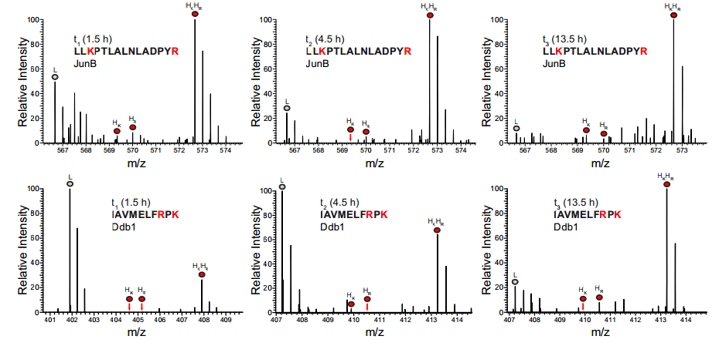
Measuring turnover – Proteins
Answer: The degree of L amino acids incorporated after transferring cells to H medium can be evaluated by inspection of mass spectra of missed cleaved tryptic peptides which contain two labelled amino acids (R and K)
Notes:
האלו שמסומנים באיזוטופ הכבד הם ארגינין (R) או ליזין (K) ואלו גם המקומות שבהם נעשה החיתוך. זה מאד מקל את החיפוש לזהות של הפפטיד.
חוץ מזה זה מבטיח שכל פפטיד יכיל חומצת אמינו ברת מדידה.
מנצלים mis cleaved peptides לבעיה האמורה.

Slide 13
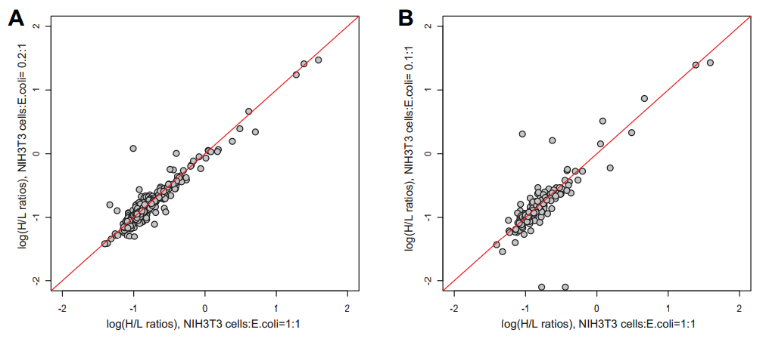
Measuring turnover – Proteins
Another possible bias may come from overestimation of abundant protein
Effect of protein abundance on H/L ratios measured by mass spectrometry.
Different amounts of the NIH3T3 lysate were mixed with the same amount of E.coli lysate to simulate different protein abundance.
Comparing the H/L ratios for NIH3T3 proteins in the mixtures revealed that H/L ratio measurements are not affected by protein abundance

Slide 14
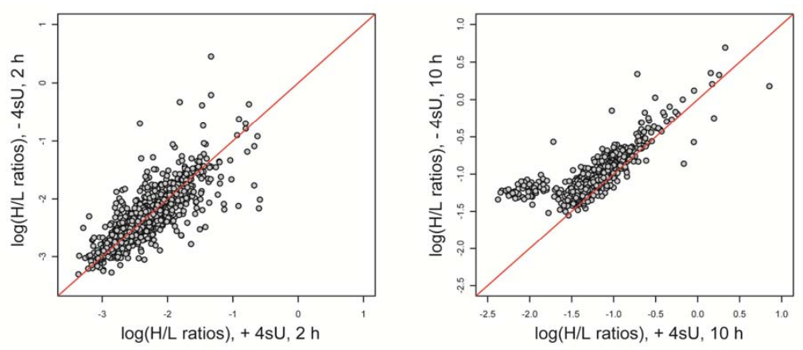
Measuring turnover – Proteins
The authors found out that 4sU decrease protein turnover after 10h of labeling (but not after 2h)
Therefore they exclusively added 4sU to the cells used for measuring mRNA
For For protein turnover measurement we did not use 4sU

Slide 15
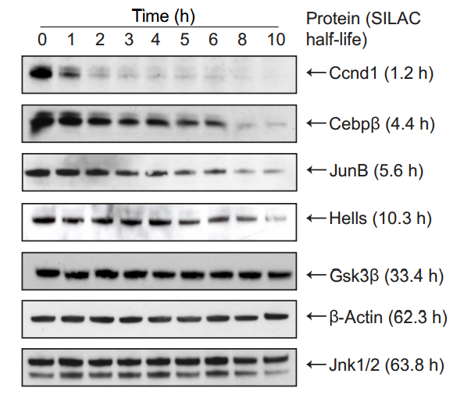
Measuring turnover – Proteins
Cycloheximide chase experiments for selected proteins agreed well with half-lives calculated
Selected proteins spanning a representative range of half-lives
Notes:
ציקלוהקסמיד מעכב תרגום.
(אפשר להשיג T1/2 רק ממנו, אבל עדיף שלא בגלל האפקט הטוקסי)

Slide 16
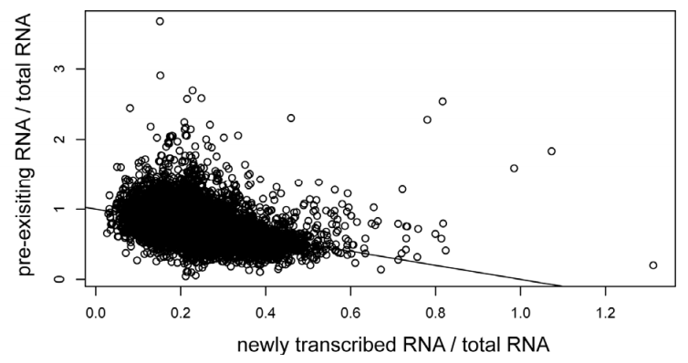
Measuring turnover - mRNA
For mRNA data the computation was essentially the same
The small letters:
mRNA counts were converted to RPKM values
Filtering transcripts with RPKM > 1 in all 3 samples
A bias correction was applied according to number of uredines in transcript (next slide)
Normalization steps were taken
A single time point was considered
$$T_{1/2}=−tln{\left(2\right)}/{ln}\left(1−1/{\left(1+{Ratio\left(existing/total\right)}/{R\left(new/total\right)}\right)}\right)$$
Notes:
ה-scatter plot מראה שיש RNA-ים שהתחלף לגמרי הישן בחדש שעתיים אחרי, ויש כאלו שפחות. ויש גם כמה שחייבים לעשות להם exclusion כי ה-ratio גדול מ-1!!!
המשוואה – אותו הדבר כמו עם החלבונים אבל בנקודה יחידה (קל לפתח). עם זאת, נשים לב כי יש שימוש ביחסים, מכיוון שהמדידה של ה-RNA היא יחסית.

Slide 17
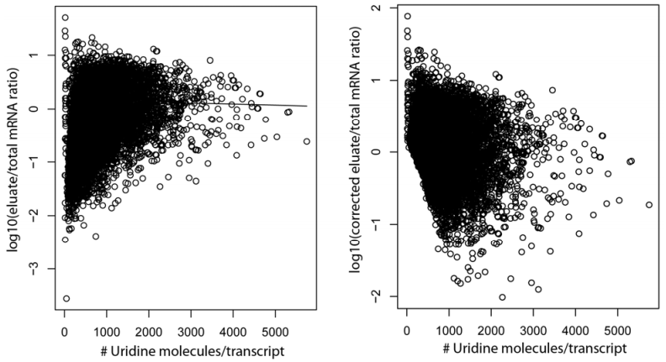
Measuring turnover - mRNA
Newly synthesized transcripts containing more 4sU molecules are more prone to be sequenced
To correct for such bias in pull-down efficiency of mRNA containing different number of uredines, LOWESS was applied
Notes:
Elute (כולל את ה-newly synthesized)
LOWESS = locally weighted scatterplot smoothing, סוג של שיטת רגרסיה לא פרמטרית.

Slide 18
Measuring turnover - mRNA
mRNA half-lives were compared to previous data.
Dolken and co-workers used 1h 4sU labeling combined with microarrays to quantify half-lives in the same cell line
The correlation was high before the 4sU bias correction (r = 0.64) and slightly reduced afterwards (r = 0.59)
On average, the half-lives were considerably longer (median half-live of all transcripts 7.6 h) than in the Dolken dataset (4.6 h)

Slide 19
Experiment – Absolute Levels
Absolute values of proteins
Sum all peptide intensities
Divide by the number of theoretically observable peptides
Plot against known molar amounts of spiked-in standard proteins, and use linear regression to deduce absolute levels
Use bootstrap to asses uncertainties in coefficients
Divide by number of cells and multiply by avogadro number – to get molecules/cell
Notes:
spiked-in standard proteins – קרוי UPS2. חשוב שיכיל חלבונים בכמויות ידועות ועל פני טווח גדול ומייצג.

Slide 20
Experiment – Absolute Levels
mRNA \ cell
Calculate total mRNA mass
Calculate the average molecular weight of a nucleotide (using ACGU ratios)
Calculate molar concentration of nucleotides per cell
Copy number of specific mRNA per cell
Reads mapping uniquely to transcript / total number of reads * transcript length
Notes:
Total mRNA concentration – למעשה החלק ה-Polyadenylated.

Slide 21
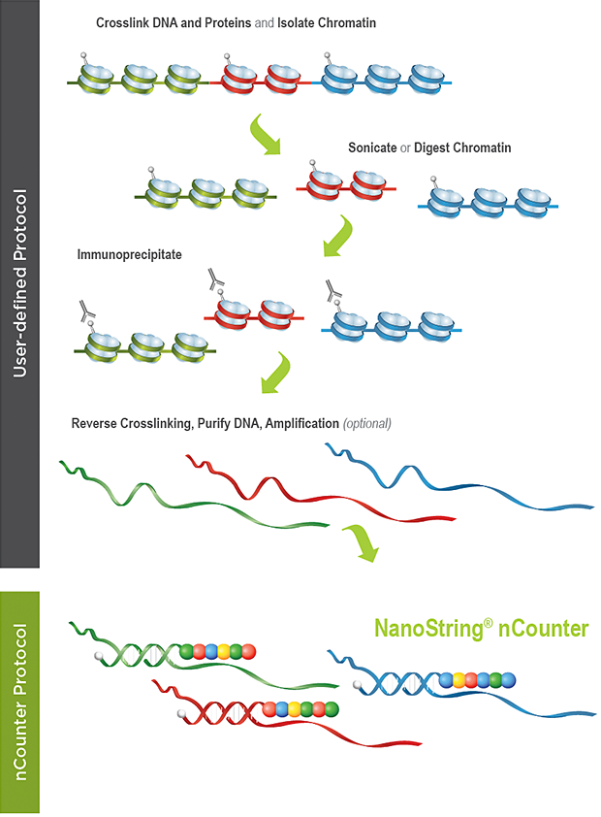
Experiment – Absolute Levels
Validation was done using a NanoString technology
Plot spike-controls of known concentrations against NanoString counts of some of the genes
Perform linear regression to obtain the relationship of counts to concentration
Divide molar amount by number of cells and compare copy numbers
Correct for different mappability
f – the fraction of all the exonic positions on which 36nt sequencing reads that can be uniquely mapped for a transcript
Simulate sequencing reads and calculate f for every transcript
mRNA < 10% - exclude, other – multiply by mean / f (mean = 72%)
Notes:
Nanostring- שיקוע של חלק מהגנים שמדדנו בניסוי באמצעות נוגדנים ספציפיים וספירה.
סימולציה של f – כאילו הייתה קריאה אחת מכל נקודה אפשרית בטרנסקריפט (חוץ מה-25 האחרונים)

Slide 22
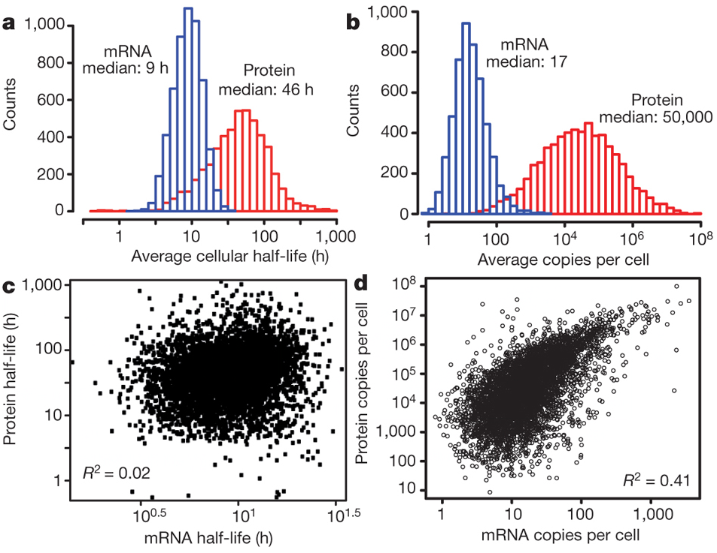
Absolute Levels, Measuring turnover - Results
Proteins were on average 5 times more stable and 2,800 times more abundant than mRNAs and spanned a higher dynamic range
The dynamic range of protein stabilities may be even higher (cannot measure very short and very long half-lives)
Although mRNA and protein levels correlated significantly, correlation of half-lives was virtually absent

Slide 23
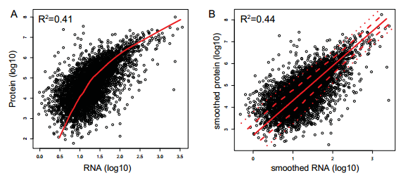
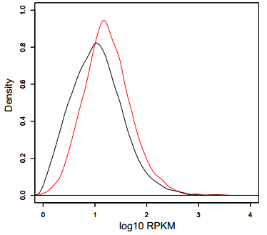
Absolute Levels, Measuring turnover - Comments
Using lowess didn’t increase correlation by much
There is a detection bias against lowly expressed proteins
Notes:
העקומות מתחת – באדום ה-density עבור גנים שזוהו ברמת החלבון. בשחור עבור כל הגנים.

Slide 24
Absolute Levels, Measuring turnover - Reproducibility
Replicate → overall correlation of half-lives and levels was good
Removing less-consistent data points did not significantly increase correlation between mRNA and protein levels or half life
Noise has little impact on the correlations
Nanostring validation of mRNA copy numbers – r=0.79
Spike-in experiments of protein copy levels – r=0.94
Cyclohexamide-chase+SILAC validation of protein T_{1/2}(T_{1/2}< 10h) – r=0.70
Translation rate validation – r=0.92
Actinomycin-D to measure mRNA T_{1/2} – r=0.70
Transcription rate validation - r=0.89 (With systemic bias)
Notes:
הסרת נקודות פחות עקביות – באופן קונזיקוטיבי ותוך מעקב אחר הקורלציה. פחות עקביות ביחס ל-replicate
כשעוצרים transcriptionאו translationממשיך לדעוך מעריכית -> מאפשר מדידה.
עבור חלבונים: באוכלוסיה אחת שגדלה במדיום כבד, לא מטפלים, ובשנייה במדיום הקל מטפלים (ואז בה דעיכה מעריכית. נקבל R(t)=H/L(t)=P0/P0(-kdpt).
אבל איך מודדים קבועי translation\transcription – מניחים שהריכוז באוכלוסייה במצב יציב בזמן הקצר שבו נותנים את הרעלן ושאין שינוי במספר התאים, ואז שימוש ב-Pss או Rss (הנחת המצב היציב). (אפשר תמיד להשתמש בהנחת המצב היציב, אבל כנראה רוצים להשתמש בזה באותו ניסוי בו השיגו את ה-Kdp
עוד בעיה – הגישה טובה כדי לוודא רק חלבונים / mRNA עם turnover גבוה כי אחר כך אפקט טוקסי.
ההערות – חביבות. אחת מדגישה שצריך חלבונים קצרי חיים בשביל המדידה כי אחרת האפקט הטוקסי משפיע על זמני הדגרדציה.
השנייה מדגישה שעם Actinomycin D יש ייצוב mRNA מושרה סטרס שיוצר מראה כאילו קצב הייצור של ה-mRNAגבוה)

Slide 25
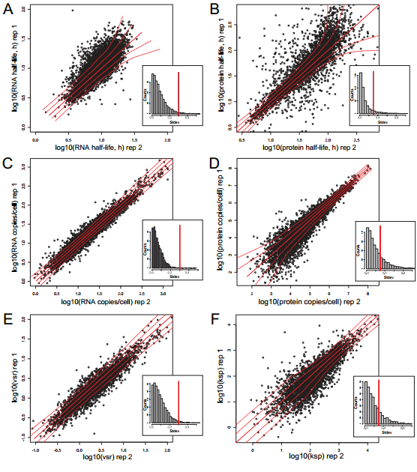
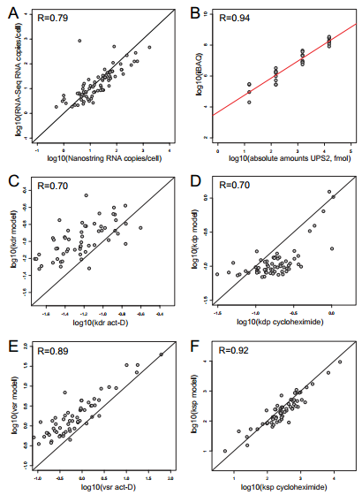
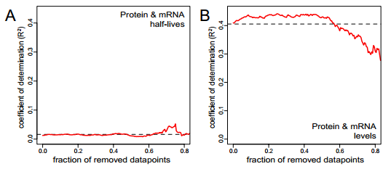
Notes:
שמאל למעלה – רפליקט.
שמאל למטה – הורדת נקודות לא עקביות לא משפרת קורלציות
ימין – ולידציות שונות

Slide 26
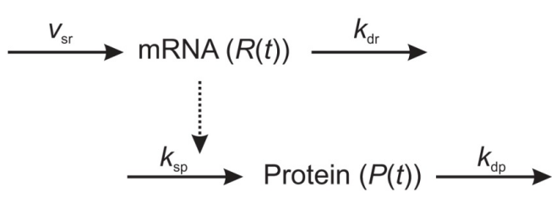
Quantitative model of gene expression
A system of ordinary differential equation:
Notes:
להדגיש שזה minimal model.
לפתור על הלוח (להדפיס לפני)

Slide 27
Quantitative model of gene expression
Scenario A
Cell cycle duration= 80h
Protein half life is 46h ± 10h
How to calculate translation rate in this scenario?
Scenario B (real data)
Cell cycle duration= 27.5h
Protein half life median is 46h
How is this situation different?
Notes:
לומר מה הנחת המצב העמיד Rss=vsr/kdr ו-Pss=Rss*ksp/kdp
והעובדה שבמצב החדש יש dilution effect.

Slide 28
Quantitative model of gene expression
Assuming a homogenous distribution of non-synchronized cells over the duration of one cell cycle, the measured population mean of mRNA and protein is set equal to the averaged copy number of one cell cycle
The mRNA and protein copy numbers at the beginning of each cell cycle is half the numbers at the time of cell division
Notes:
להדגיש שזה minimal model.
לפתור על הלוח (להדפיס לפני)

Slide 29
Quantitative model of gene expression
Notes:
משוואות סופיות

Slide 30
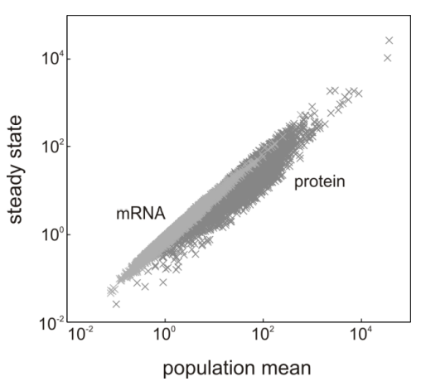
Quantitative model of gene expression
Use average mRNA copy numbers → transcription rate
Use average protein copy numbers → translation rate
If we assume measured levels reflect steady-state values
For transcription rate - similar results
For translation rate – differ partly more than one order of magnitude
Model drawbacks
Expression in mammals is nor continuous
Uniform cell age distribution

Slide 31
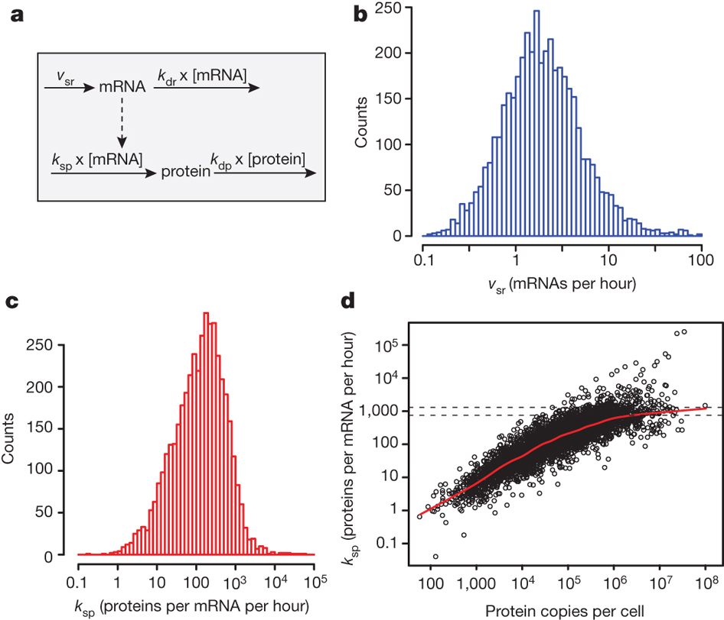
Quantitative model of gene expression - Results
Transcription
Predicted rates spanned two orders of magnitude with a median of about two mRNA molecules per hour
Extreme example – Mdm2 >500 mRNA per hour
Translation
Median~40 protein\(mRNA*hour)
Several proteins involved in translational regulation had extremely low rate constants
Abundant proteins are translated *100 faster than less abundant.
Saturation at 1,000 protein\(mRNA*hour)
Notes:
למה mdm2 מעניין במיוחד. כי הוא אונקוגן שגורם התמרה סרטנית (לפי ויקיפדיה) בפיברובלסטים. אז יכול להיות שזה רק ב-cell line הזה ☺
למה חלבונים רגולטוריים מעניינים – כי רואים פטרנים. למשל דיכוי ברמת התרגום עבור חלבונים רגולטוריים.
הגבול העליון – לא ברור לגמרי. לא היה ידוע מה הגבול העליון ביונקים. בהשוואה ל-sea urchin embryos הגבול העליון של היונקים כפי שמשתקף כאן פי 7 יותר גבוה.

Slide 32
Control of gene expression
Sequence features
Translation initiation (e.g., Shine Dalgarno)
Elongation (e.g., codon bias)
Protein stability (e.g., degrons)
Novel sequence features found in this experiment
mRNAs with long 3’ UTRs → Less stable
Density of AU-rich elements and binding motifs of a specific-binding protein (pumilio) → Less stable
Unstructured proteins → Less stable
Certain amino-acids over-representation → Less stable
Notes:
Shine dalgarno – אתר קשירה לריבוזומים (בפרוקריוטים, לא בכיתתנו ☺). Degron – סימון התחלת דגרדציה

Slide 33
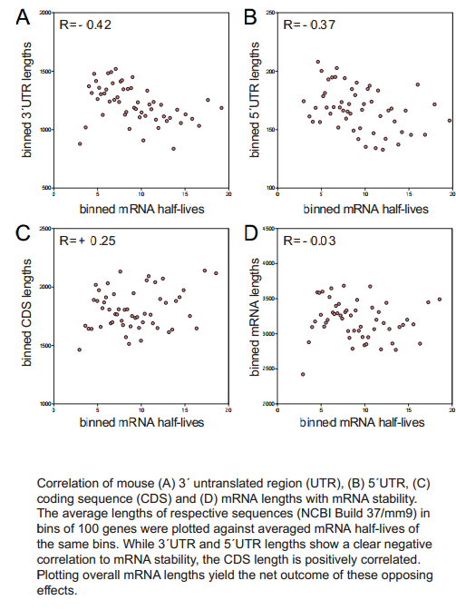
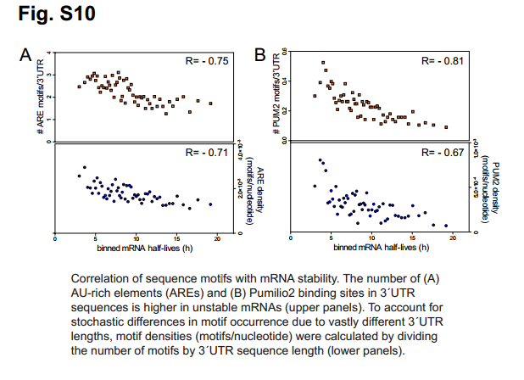
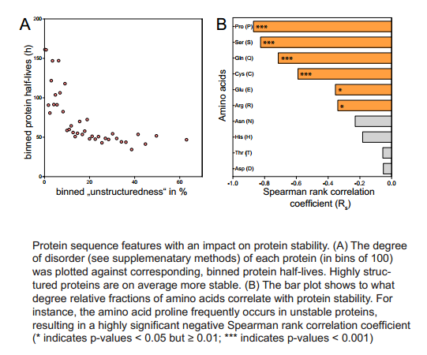
Experiment - Control of gene expression

Slide 34
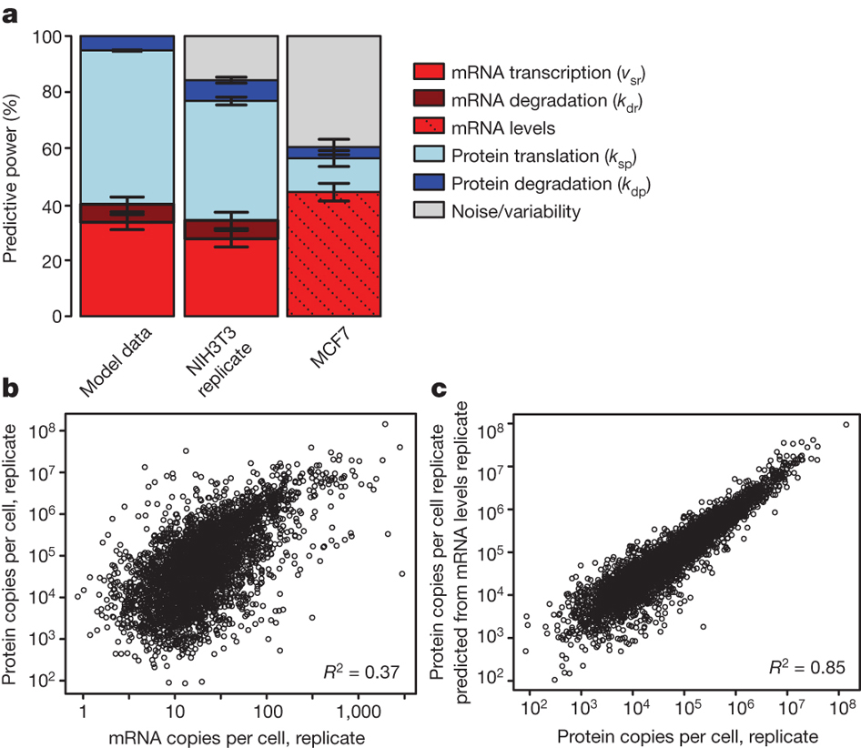
Control of gene expression
Protein levels are best explained by translation rates, followed by transcription rates. mRNA and protein stability is less important
Combining mRNA copy numbers translation rate constants elevates R² from 0.41 to 0.95
To check for over fitting the same analysis was done on a replicate, predicted protein levels agreed with measured protein levels
Notes:
אני לא לחלוטין הבנתי איך הם השיגו את הרכיבים הללו (אין לי את הידע הסטטיסטי).
C – הרפליקט. לא ברור במה הם השתמשו מהמדידות בו. כנראה רק בחלבון ממנו ובקבועים מהניסוי המקורי. המתאם 0.85, קרוב מאד למתאם בין רמות החלבון בין הרפליקט והניסוי (0.84) (ככה לפי מה שהם טוענים, כשאני בודק cor^2 ב-R אני מקבל מתאם של 0.90).

Slide 35
Control of gene expression
Are the rates retained in a different cell type and organism?
mRNA and protein abundance were quantified in human breast cancer cell line MCF7 (RNA-seq, mass spectrometry)
2,030 human genes from the MCF7 data set had orthologues in the mouse fibroblast data
Predicting protein levels from mRNA levels in MCF7 cells using those rates → the model predicted ~60% of the variability in protein levels .
Translation and degradation rates are to some extent independent of the cell type and conserved between mal
The drop in prediction is mainly due to the translation part performing less well.
Notes:
גם החיזוי ב-MCF7 לא ברור לי

Slide 36
Half-lives and gene function
Genes may have evolved specific combinations of mRNA and protein half-lives under functional constraints
mRNA stability is important for the temporal order of gene induction
Protein stability is important for example to cell cycle progression
Genes were grouped according to their half-lives and enrichment analysis was performed
Notes:
גם החיזוי ב-MCF7 לא ברור לי

Slide 37
Half-lives and gene function
 | Stable Protein | Unstable Protein
Stable mRNA | Constitutive cellular processes (translation, respiration, central metabolism) | Extracellular proteins Cellular homeostasis Defense response Proteolysis
Unstable mRNA | Processing of mRNAs , tRNAs, non-coding RNAs | Transcription factors Signaling genes Chromatin modifying enzymes Cell-cycle-specific functions
Notes:
Constitutive cellular processes - translation, respiration, central metabolism
Unstable are transcription factor \ signaling genes etc. – Like timers that controls the persistence of genetic information
Stable proteins unstable mRNAs - Many RNA-binding proteins bind their own message→observation is indicative of a post-transcriptional negative feedback loop for RNA-binding proteins. The unstable mRNAs were enriched for binding motifs of RNA-binding proteins (to Yaron?)
Unstable proteins – 1. Extracellular proteins – have short duration in cell… Also Ferritin which is created in response to iron, completely translational regulated (as potentially others in this group)
העשרה ב-David

Slide 38
Half-lives and gene function – Stable-Stable
Why genes related to Constitutive cellular are more stable?
Possible reason – Energy constrains
Modeling the cost as
mRNA synthesis = (transcription rate * primary transcript lengths * 2 ATP) + 2 ATP
Protein synthesis (translation rate * protein length * 4 ATP) + 3 ATP
Protein synthesis requires 90%, mRNA synthesis 10% of the energy
BUT 20% of the proteins consumed 80% of the energy for translation.
Consistently, abundant proteins are found to be more stable than less abundant ones (P<10⁻¹⁵ Wilcoxon test)
This is not necessarily expected
Notes:
לזכור – נפוץ יותר מקושר ליציב יותר מקושר לקצר יותר.
אגב, הקשר בין חלבונים נפוצים ליציבות הוא לא כ"כ צפוי. כי הרי התרומה של הדגרדציה לרמות חלבון היא יחסית נמוכה (לפי מה שראינו). חוץ מזה החלבונים הנפוצים יותר קצרים יותר (ומסיבה לא ברורה במאמר מניחים שזה אומר שהם צריכים להיות פחות יציבים)
2 לכל נוקלאוטיד + 2 לאתחול. לעומת, 4 להוספת AA (2 ל-loading ו-2 ל-elongation) + 2 לאתחול + 1 לסיום.

Slide 39
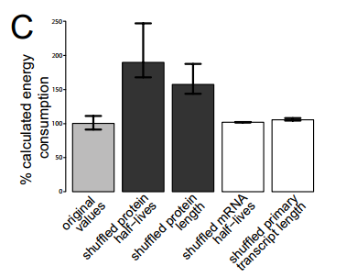
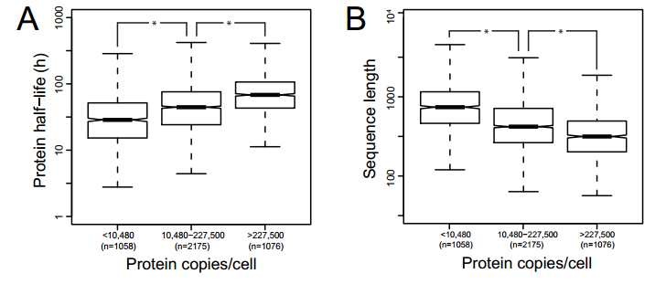
Half-lives and gene function – Stable-Stable
Notes:
משמאל – נפוץ יותר זה קצר יותר ויציב יותר.
מימין – יותר מעניין. עושים SHUFFLING של זמני מחצית חיים ורואים שהאנרגיה שהתא ישלם גדלה במיוחד, אם ישתנו זמני מחצית חיים של החלבונים. (של ה-mRNA פחות כי התרומה שלו לצריכת האנרגיה קטנה יותר)

Slide 40
Half-lives and gene function
Unstable-Unstable – Enriched in TFs\signaling genes, working as timers that controls the persistence of genetic information.
Stable(p)-Unstable(m) – Enriched in RNA-binding proteins. Many RNA-binding proteins bind their own message.
Evidence for post-transcriptional negative feedback loop for RNA-binding proteins.
The unstable mRNAs were enriched for binding motifs of RNA-binding proteins
Unstable(p)-Stable(m) – 1. Extracellular proteins – have a short duration in cell. 2. Ferritin - completely translationally regulated (as potentially others in this group)

Slide 41
Corrigendum
“As described in the original Article, slope and offset for scaling were calculated by linear regression based on an in-solution digest with spiked-in proteins of known concentrations. We erroneously used the slope and the offset from an unrelated experiment to scale protein levels, resulting in a systematic underestimation of protein levels and derived translation rate constants. We apologize for this error and any confusion it may have caused.” (Nature,2013)
Notes:
אבל הכל בסדר עכשיו, הכל הוחלף בתור המאמר.

Slide 42
Discussion
Translational control is more important than what previously thought, especially at the level of translation efficiency
From this article it is also not clear how much translation rate constants change under different conditions
The predictions in MCF7 cell line might suggest translation efficiency is ‘hard-coded’ in the genome (Recent studies do not support this conclusion!)
Compared to translational control, protein stability seems to have a minor role in cellular protein abundance in our system
The dominance of translational regulation makes sense given the high energy costs associated with protein synthesis

Slide 43
Discussion
Genes with certain combinations of mRNA and protein half-lives share common functions, indicating that they evolved under similar constraints
Energy constraints
Need to respond to stimuli (And then the gene product should be unstable at the mRNA level, protein level or both)
The data provide a rich resource for the scientific community
Notes:
מה שמודגש מוביל למה שחשבתי עליו – שהקורלציה בין רמת החלבון ל-mRNA תהיה יותר גבוהה עבור גנים שעוברים את הבקרה העיקרית ברמת ה-mRNA לעומת אלו שעוברים את הבקרה העיקרית ברמת החלבון.

Slide 44
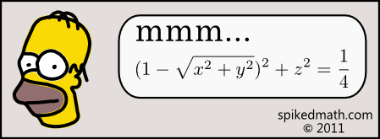
Ideas for using the Results
Not many know how to use the results
Although 737 articles are citing them
Enrichment Analysis
Proteins with similar degradation and \ or translation rates may share similar functions (evolved under same constraints)
Prediction
Predicting protein levels from mRNA
Can be used in both tissue cultures and steady-state environments
But can we do if we cannot have a tissue culture and the environment is not in a steady state?
Notes:
What can we do – למשל אולי אפשר לחזות tcc ממחקר אחר, או לפי best fit.

Slide 45
Ideas for using the Results
Comparison of this exact type of results to see source of regulation
If we had the same exact data type for a different tissue then we can distinguish between transcriptional regulation and post-transcriptional regulation
Correlation to other properties may be used to refine model
For example, we can check if genes that belong to unstable(m)-stable(p) (and thus more likely to be regulated at the transcription level) exhibit a better correlation to their matching protein levels, than genes that belong to stable(m)-unstable(p) (and thus more likely to be regulated at the post-transcriptional level)
Notes:
כאן לעצור ולהסביר כי אין לי במקום אחר מידע...
נקודה ראשונה – אין כאלו datasets שבהם הכל משולב. מתחילים להיות מדידות של קבועי קצב.

Slide 46
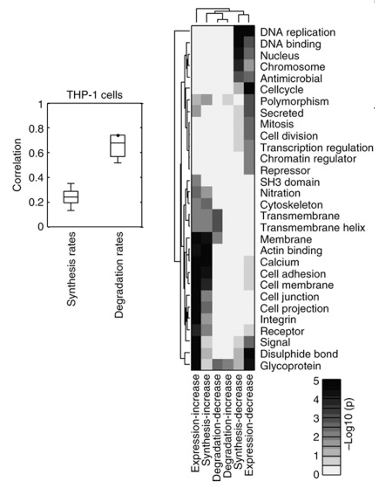
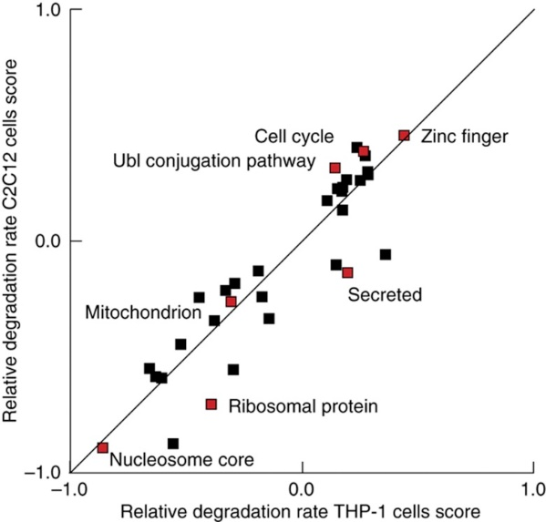
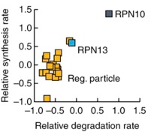
Ideas for using the Results – Enrichment Analysis
Results from Kristenen et al. (2013)
The scenario is different – differentiating cells
They measure their own rates
Synthesis and degradation rates are consistent among members of protein complexes.
Similar process were enriched in those proteins with significantly changed synthesis rates and protein expression (but not degredation rates)
Degradation rates for functional classes of proteins are largely similar (P<0.05) between two tissue types
Notes:
[1] Kristensen, Anders R., Joerg Gsponer, and Leonard J. Foster. "Protein synthesis rate is the predominant regulator of protein expression during differentiation." Molecular systems biology 9.1 (2013).‏
על הקומפלקסים – כאן מוצג זה של הפרוטאוזום. אגב, הם מדברים במאמר על כך שתמיד יש כמה בתוך הקומפלקס שהם שונים.
תאי לוקמיה מול מיובלסטים.

Slide 47
Ideas for using the Results – Prediction
mRNAs levels usually serve us as proxies to protein levels
We actually want to perform enrichment analysis on protein levels
I tried to apply a simple prediction on my data assuming steady-state
Correlation of predicted protein levels to observed protein levels increased from 0.49 → 0.65 in one tissue and 0.51 → 0.58 in the other tissue, when using rates vs. using only mRNA
Interestingly for one of the tissues I got that using the fibroblasts protein levels (in steady-state) is better correlated with the observed protein levels, than the prediction that used the observed mRNA levels and the rates (0.58 → 0.64)
Maybe protein profiles are more correlated between cell types than synthesis rates
Notes:
להזכיר גם את העקומה מהשקף הקודם שמדגישה שזמני סינתזה משתנים...
המשפט האחרון נכון כפי שראיתי בהסתכלות על החלבון ועל ה-mRNA בוסטיבולה ובקוכליאה – קורלציות 0.96 ו-0.93. קורלציה של יחסים – 0.77 בלבד.
לדבר על ניסיונות של GSEA (כדי להבין בדיוק מה המקור לבעיה)?
לדבר על זה שהרבה מאמרים טוענים שה-post translational זה בעיקר fine-tuning?

Slide 48
Kobi Perl
kobipe3@gmail.com
Department of Human Molecular Genetics and Biochemistry
Tel-Aviv University

Slide 49
Notes:
Last slide

Slide 50
Leave One Out Cross Validation
LOOCV sum of squares (CVSQ) for the linear regression slope):
$$CVSQ=\frac{1}{n}\sum_{i=1}^{n}{{\left(β−β_{i}^{\left(−r_{i}\right)}\right)}^{2}}$$
Where $β$ is the slope of the regression curve using the original number of time points and $β_{i}^{\left(−r_{i}\right)}$ the slope of the regression curve after removing the ratio $r\left(t_{i}\right)$. The number of time points is n.
The relative cross validation sum of squares (CVSQ/β)) reveals that 93% of the slopes vary on average less or equal to 1% if one data point is removed
This is 95% of the linear regression fits that satisfy the condition $R^{2}≥0.9$

